Slide 1







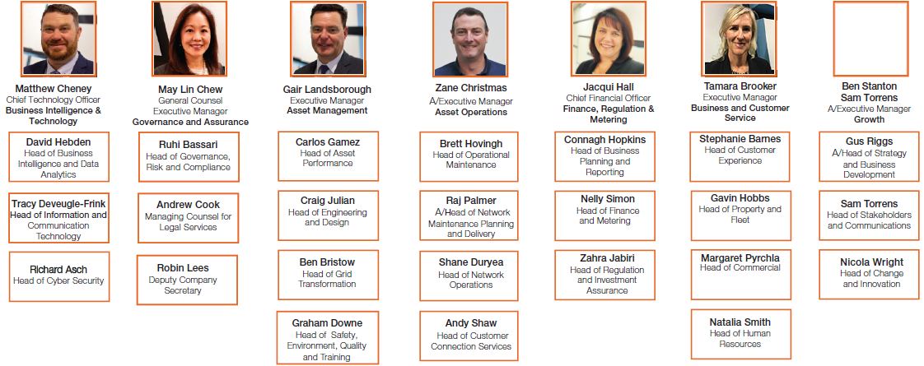
Opportunity: Controller Roster Review
Initiator: Dugald Bell
Proposed Sponsor: Dugald Bell
Context
There is currently 22 controllers and 2 team leaders whose responsibility is to write switching programs for planned work and provide relief to the Control Room during busy periods.
Alignment with Values
Safety First
Customer Focus
Be Bold
Teamwork
Alignment with
AO 3-year plan
Safe
Reliable
People
Affordable
Operational Excellence
Business Problem
The current roster does not meet the current work requirements (what requirements?). It is not aligned to the control room roster as the Controllers EA is for 9.5 hrs whilst the Control Room operates in 12.5 hr shifts and does not account for the fact that controllers currently have the flexibility to nominate their chosen work site. The ability of Controllers to dictate their worksite is unfeasible. The current roster is creating a division within the controllers whilst also preventing controllers from spending enough time in the control room. It has been stated that the controllers need to spend more time in the control room to allow skill retention and development.
Currently 11 controllers do not have the required competencies and therefore can only work as Program Writers. There is no tolerance in the current roster to allow for the necessary training.
Pillar fit
1. Optimise core operations
2. Strengthen the culture
3. Operationalise & scale future capabilities
Fits under which 3-year plan project?
(See EDM59768417)
Dependencies or other aligned initiatives
Benefits
Cost reduction
$0 - $500,000 $500,000 - $1M >$1M
Opportunity
The opportunity is three fold. Firstly, develop a roster that meets current operational requirements and is aligned to the control room roster (does that include location yes it does). Secondly, drive cultural changes that encourages camaraderie and standardise working arrangements. Thirdly allow program writers the time to complete the training required to work in the control room. A new roster must be designed to have designated training days for each employee.
Increased productivity
Low Medium High
Customer Satisfaction
Low Medium High
Risk to be mitigated
N/A Low Medium High Extreme
Organisational / Business Impact
Project Duration
Up to 6 months
6 – 12 months
>12 months
Key Stakeholders/SME’s
Dugald Bell
Nathan Hill
Andrew Barwise
Darko Nenadic
Human Resources
Operational Improvement BP
Investment Requirements (funding)
$0 - $0.5M $0.5 - $1M > $1M
Resource Requirements (FTE/SME)
L
M
H
1
5-10
10+
OI BP: Andrew Barwise
Date: 24/08/2022
EDM:

